Slide 1


Growing & Utilizing
Revenue, Fundraising & Reinvestment
Notes:
SG - Welcome and introduction of presenter(s)
There are a lot of ways that associations raise revenue.
Memberships, tournament entry fees, raffles, fundraisers and many more.
We raise money to give it away…
But, there are misconceptions that associations can’t earn money for their general use.
If you raise money in a 50/50 – where does it go?
You would probably say it goes to BVL, Bowl for the Cure, or youth – but we don’t think about our general fund.
This is not to say that BVL or Bowl for the Cure aren’t important, but we need to learn to invest in our association, as well as our members.
The more money we raise for our association as a whole, the more impact it will have on all of the other things we raise money for.
So, are you ready to learn how to grow, promote and invest in your association and create a Future for the Sport?
66

Slide 2
Revenue, Fundraising & Reinvestment
Non-Profit Organization
A group organized to serve a stated mission or purpose; that does not declare a profit and instead utilizes all revenue available after normal operating expenses in service to that stated mission.
Notes:
Let’s take a step back for a minute and talk about non-profit status.
What is a non-profit organization?
67

Slide 3
Revenue, Fundraising & Reinvestment
USBC’s Tax Exempt Mission:
“To develop interest and participation in the sport of bowling overseeing competition and providing programs and services to its membership.”
“Profits” must be reinvested to support/drive the mission or purpose.
Notes:
Let’s take a step back for a minute and talk about non-profit status.
What is a non-profit organization?
67

Slide 4
Revenue, Fundraising & Reinvestment
What have been your most successful fundraising strategies?
Discussion
Notes:
Name this Poll?
69

Slide 5

Growing & Utilizing
Revenue, Fundraising & Reinvestment
  Hershey’s Fundraising
  Silent Auctions
  Coffee & Water fundraising
  FundCrazr
  4 Imprint
  Kroger Cares
  In-kind donations
  Association Nights at Sports Venues
  Restaurant Nights
  Casino Nights
Notes:
HC
71

Slide 6

Revenue, Fundraising & Reinvestment
“Strike Up Your Appetite Night”
Easy to Organize – Restaurants handle cooking, staffing, and cleanup, making it a low-stress way to raise funds.
Supports the Local Community – Partnering with a neighborhood restaurant keeps money circulating locally and builds goodwill.
Brings People Together – Members, families, and friends gather for food and fun, strengthening relationships off the lanes.
Earns Funds While You Dine – A percentage of every meal directly benefits your association without extra selling or upfront costs.
Notes:
HC
71

Slide 7

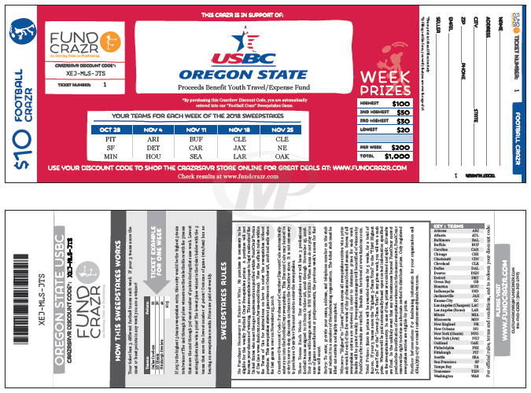
Growing & Utilizing
Revenue, Fundraising & Reinvestment
Notes:
HC to cover
72

Slide 8

Revenue, Fundraising & Reinvestment
“one by one®” Grant
“Through one by one®, we award $500 grants for promotional products to organizations that are making a difference. This helps them spread the word, recruit volunteers, thank donors, or in some other way turn one thing into something much more. We award several grants each business day.” -4imprint
Notes:
SG
4Imprint grant that can get you free items – décor and branding items for your events
74

Slide 9
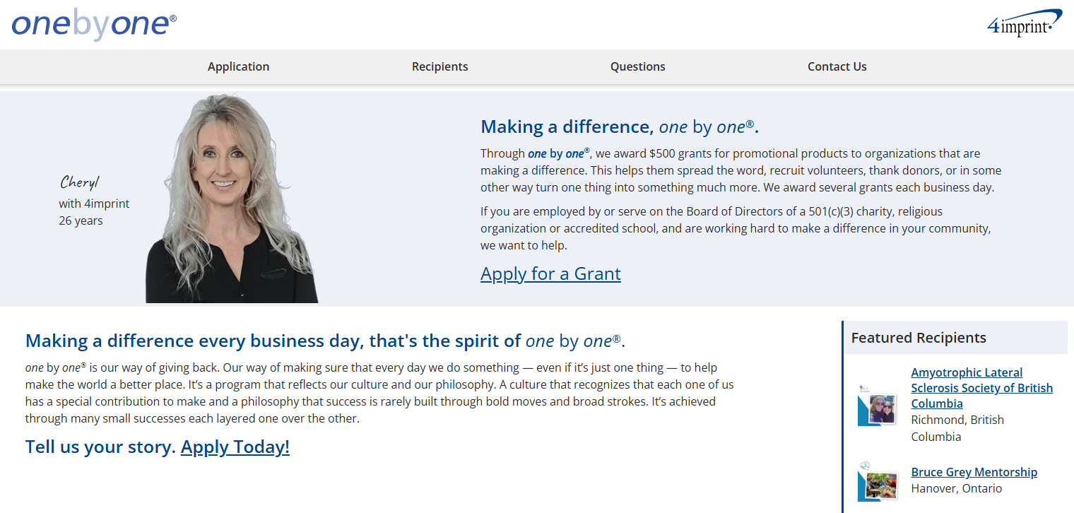
Revenue, Fundraising & Reinvestment
  Any Board of Directors member of a 501 (c)(3) organization can apply
  Application is due two months before your event
  Can only receive the grant once every 12 months
    If denied, can reapply every 6 months
  Recipients are determined by location, programming diversity, merit of cause, and audience served
“one by one®” Grant
Notes:
Do we need this?
75

Slide 10
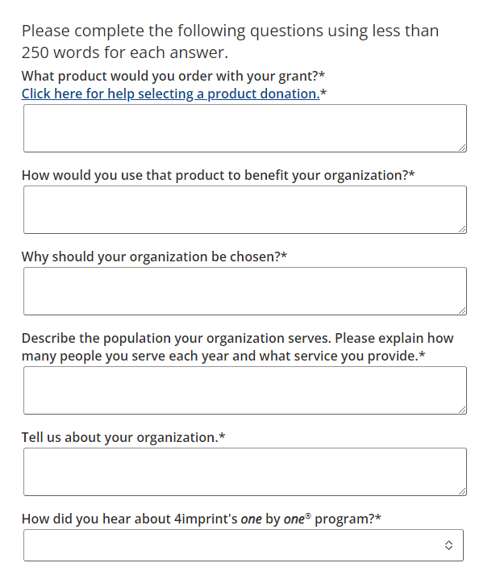
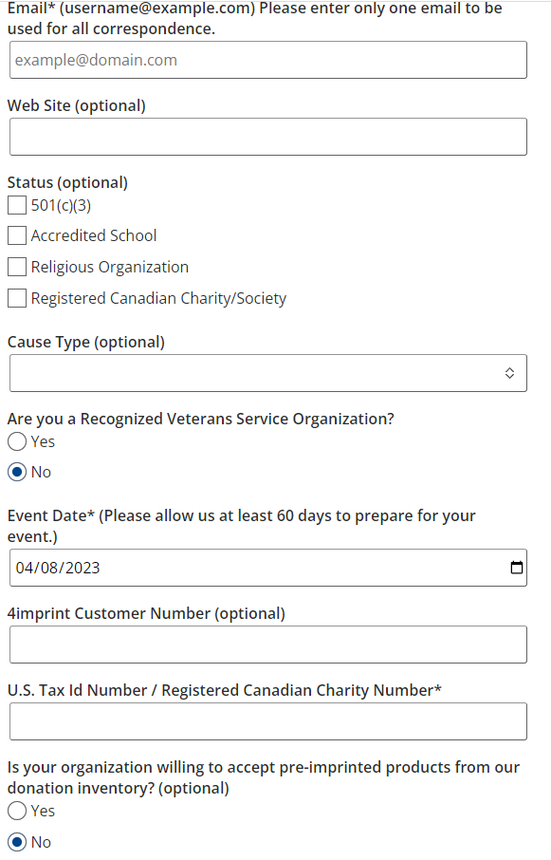
Revenue, Fundraising & Reinvestment
“one by one®” Grant
application
onebyone.4imprint.com
Notes:
SG Application form for the 4Imprint grant
76

Slide 11



Growing & Utilizing
Revenue, Fundraising & Reinvestment
Kroger Community Rewards
“Any transactions using the Shopper’s Card number will be applied to the program, at no added cost. Kroger donates annually to participating organizations based on your percentage of spending as it relates to the total spending associated with all participating Kroger Community Rewards organizations.”
Notes:
78

Slide 12
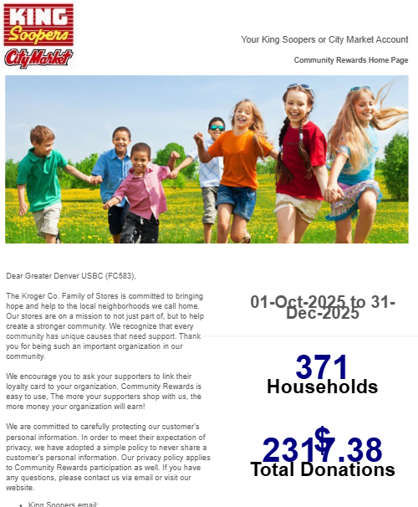
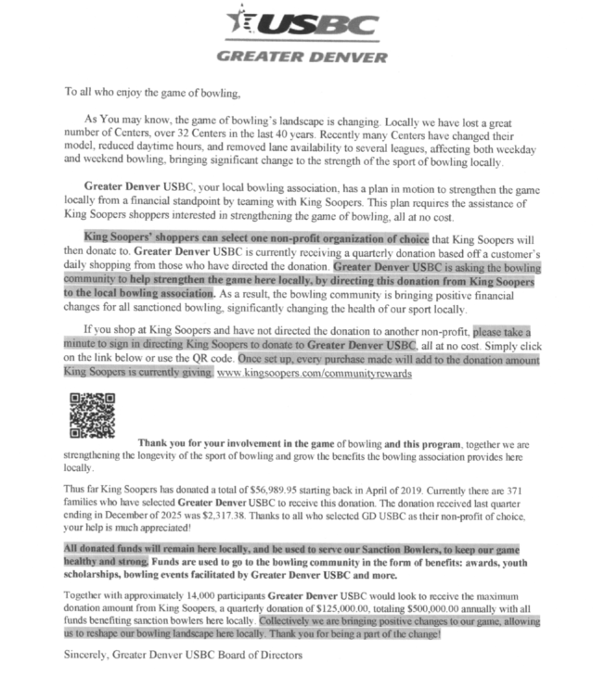
Revenue, Fundraising & Reinvestment
$2,317
Total Donations
Notes:
Totals seen here are Gr Denver
79

Slide 13
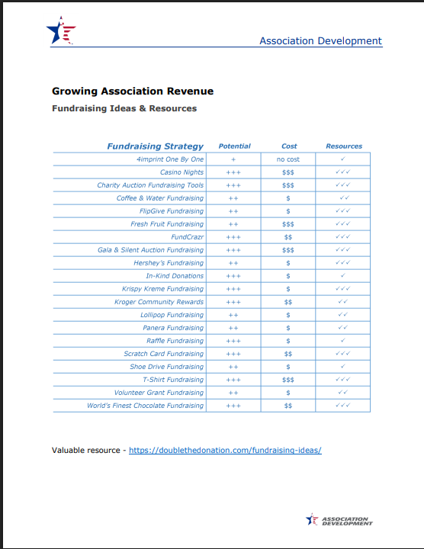
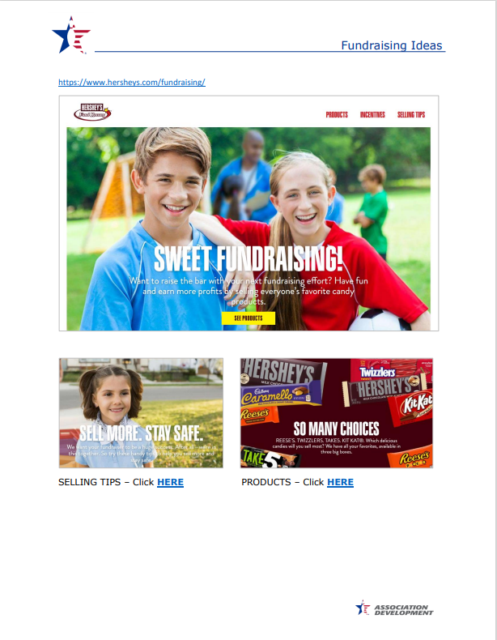
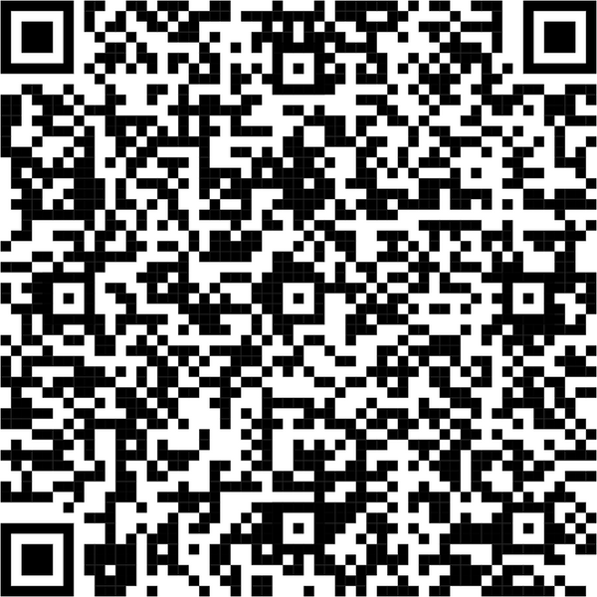
Revenue, Fundraising & Reinvestment
Notes:
83

Slide 14


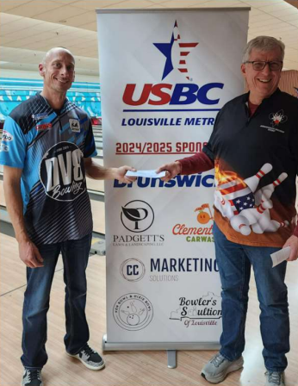
Revenue, Fundraising & Reinvestment
Learn
Build a connection with your membership
Meet
Set aside specific time to discuss opportunities
Explain and Build
Clearly describe the partnership benefits
Promote
Boost visibility for your sponsor(s) and association
Execute and Evaluate
Deliver on the agreement, evaluate success
Sponsorships
Notes:
83

Slide 15
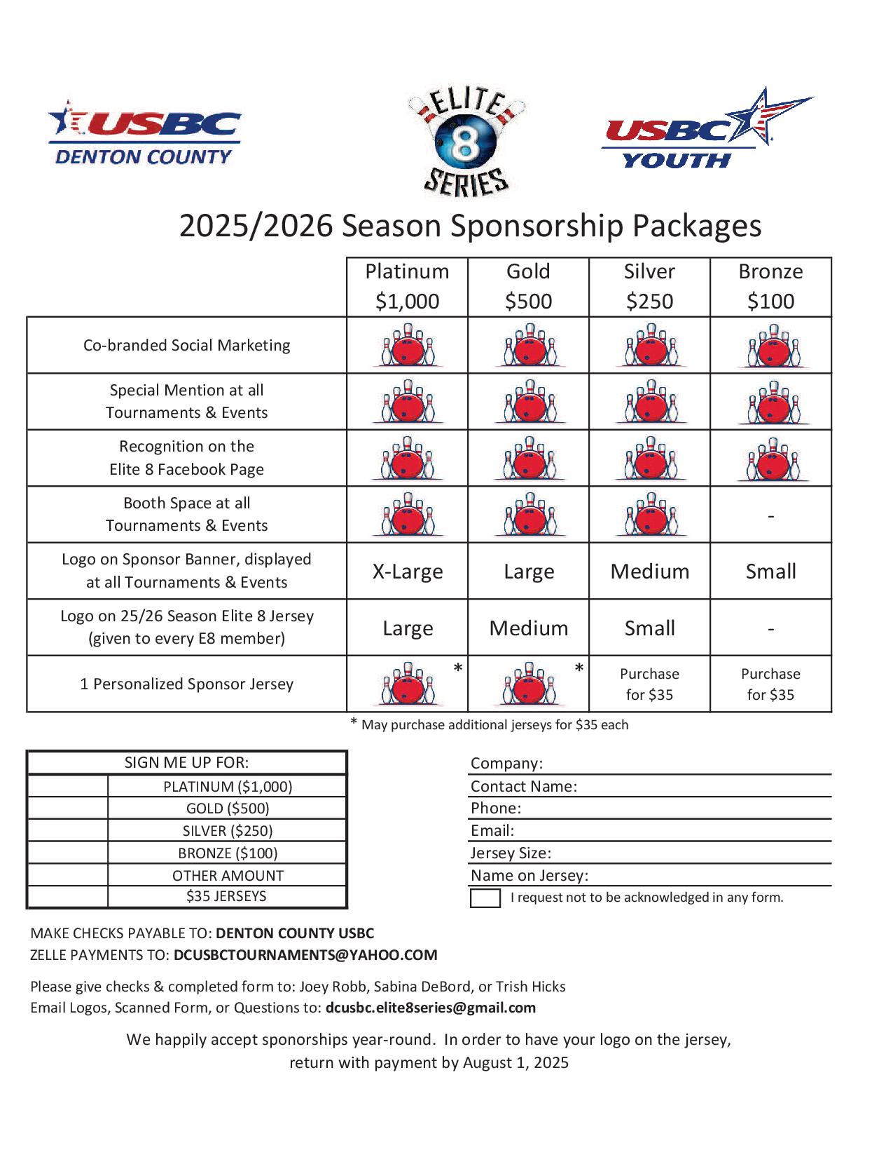
Revenue, Fundraising & Reinvestment
Notes:
Let’s take a step back for a minute and talk about non-profit status.
What is a non-profit organization?
67

Slide 16
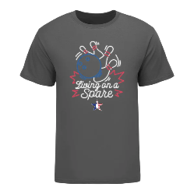






Revenue, Fundraising & Reinvestment
What to ask for?
Venues
HOF/Annual Meeting
League Secretary Workshops
Meals/catering
Raffle items
SWAG
Awards
Sponsorships
Notes:
83

Slide 17
Revenue, Fundraising & Reinvestment
If your association received an extra $5,000, how could you use that money to make the biggest impact?
Put it towards SMART Scholarships
Put it in Tournament Prize Fund
Give it to another charity
Table Talk
Notes:
HC continues
84

Slide 18
Growing & Utilizing
Revenue, Fundraising & Reinvestment
How did we reinvest our revenue to support the association and our members?
Discussion
Notes:
SG
85

Slide 19
Growing & Utilizing
Strengthening Community Impact
Notes:
SG - Welcome and introduction of presenter(s)
There are a lot of ways that associations raise revenue.
Memberships, tournament entry fees, raffles, fundraisers and many more.
We raise money to give it away…
But, there are misconceptions that associations can’t earn money for their general use.
If you raise money in a 50/50 – where does it go?
You would probably say it goes to BVL, Bowl for the Cure, or youth – but we don’t think about our general fund.
This is not to say that BVL or Bowl for the Cure aren’t important, but we need to learn to invest in our association, as well as our members.
The more money we raise for our association as a whole, the more impact it will have on all of the other things we raise money for.
So, are you ready to learn how to grow, promote and invest in your association and create a Future for the Sport?
66

