Slide 1

Marketing Your
Local Tournaments
Brooke Johnson & Auna Olshavsky

Slide 2
Agenda
Why Marketing Matters
Outreach/promotion
facebook
Resources

Slide 3
Why Marketing Matters
Growing
Increases awareness of tournaments
Promoting
Gives opportunity to reach different audiences
Engaging
Engages & connects members with the association
Building
Gives association brand recognition

Slide 4
Types of Outreach
In-Center Promotion
Word-of-Mouth
Email Blast
Facebook
Website

Slide 5
Know Your Audience
Past Participants
Facebook
League Bowlers
In-Center Promotion
Facebook
Competitive Bowlers
Website
Word of Mouth
Email
Word of mouth
Email
Facebook

Slide 6
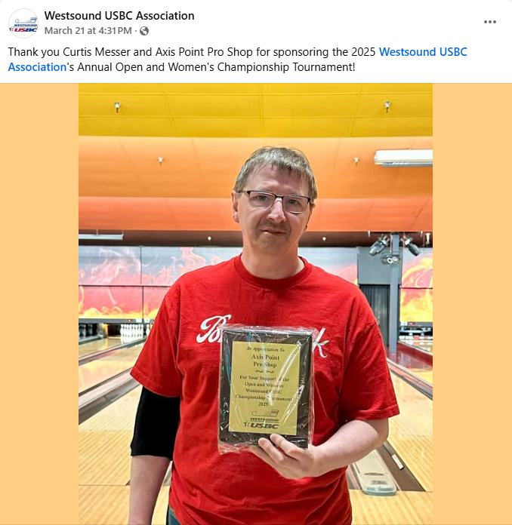
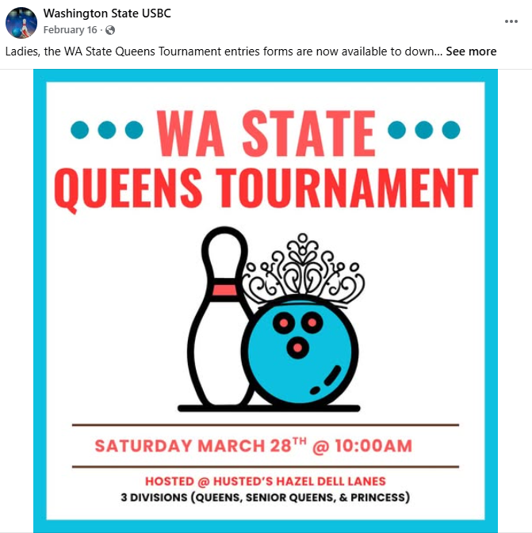
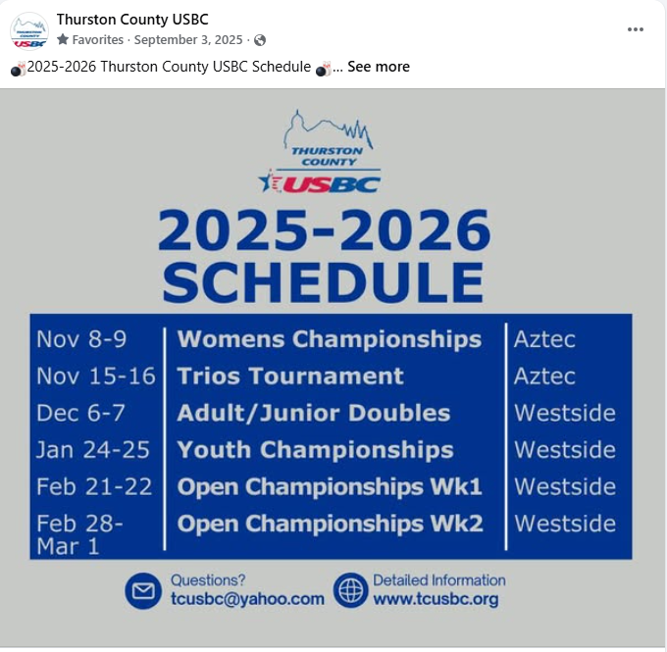
Types of Facebook Posts
Member Recognition/Prior Tournament Winners
Tournament Announcements
Schedules, Reminders, or Deadlines

Slide 7

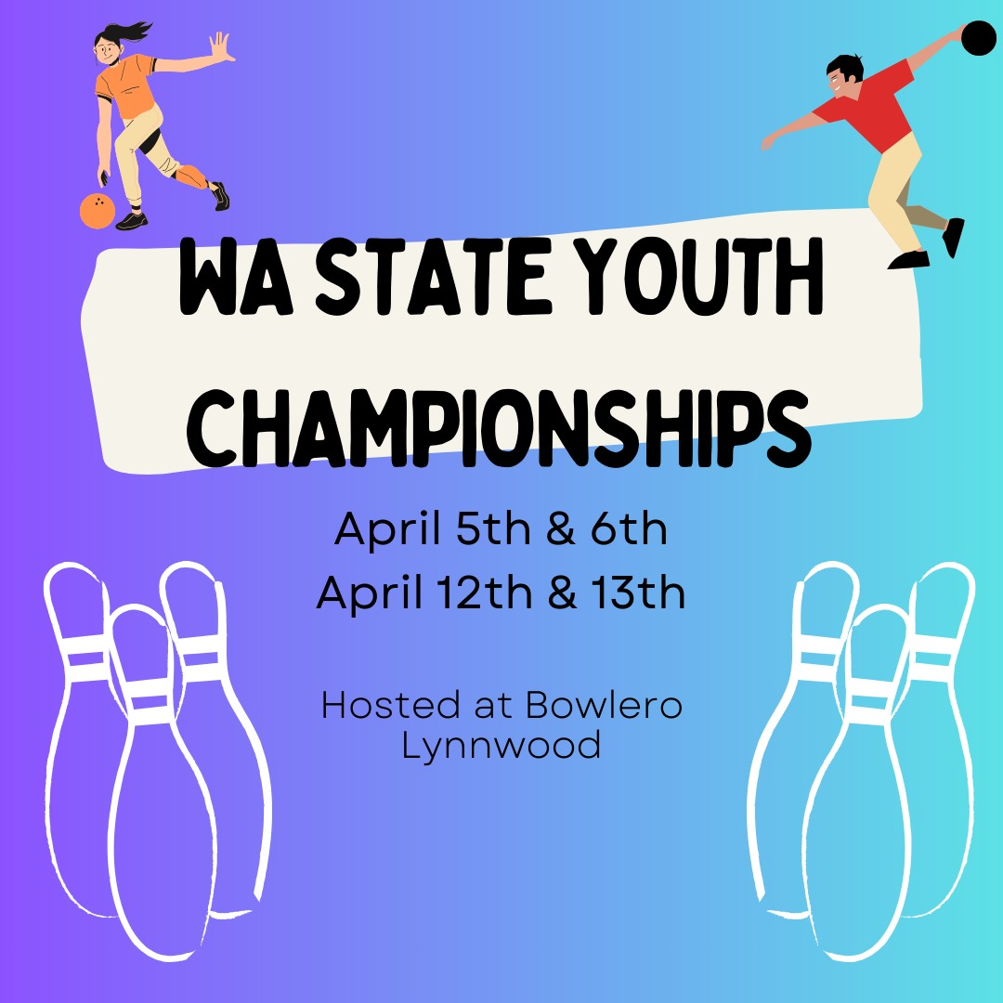
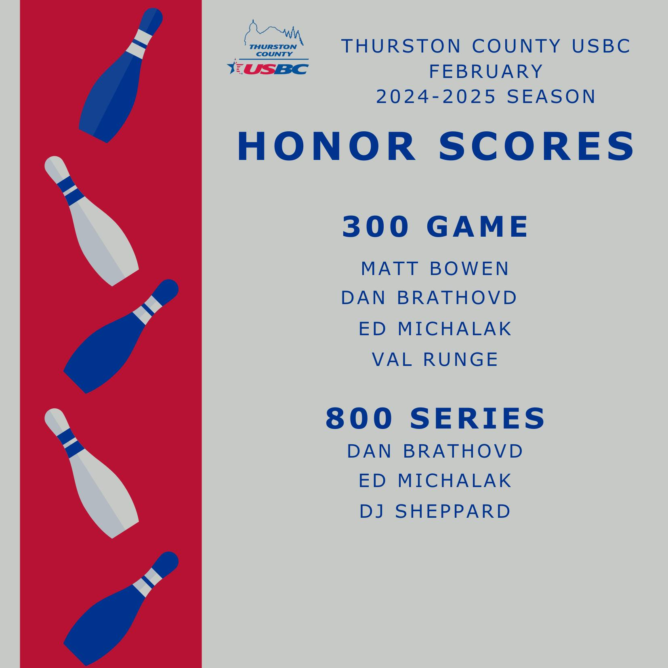
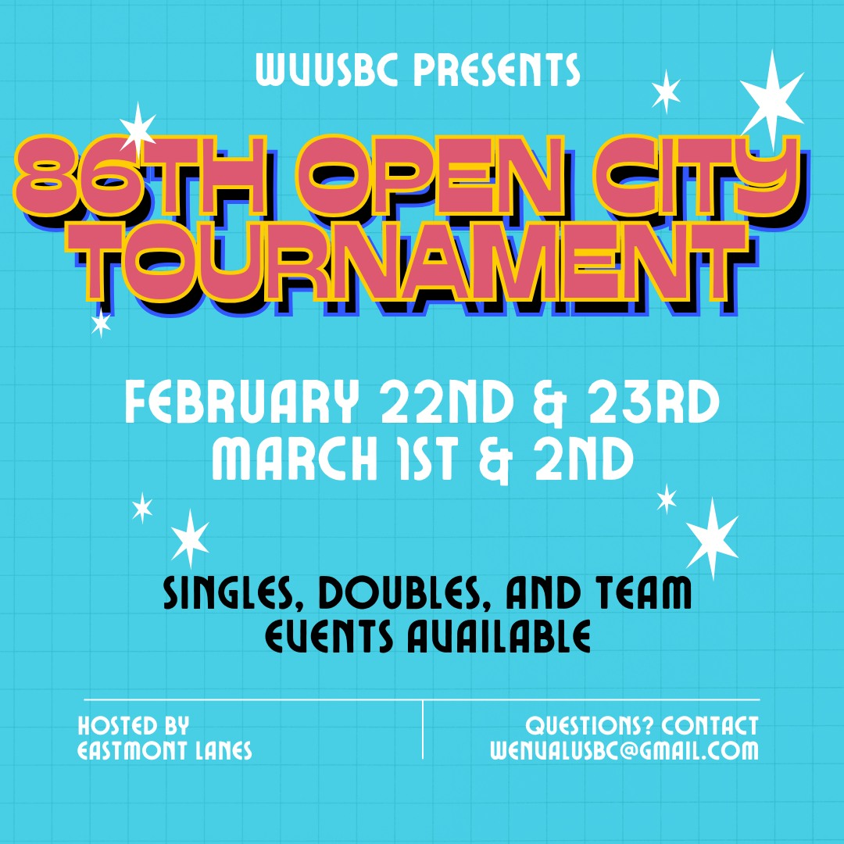
Canva for Non-Profits is FREE
Canva is a free, easy-to-use graphic design tool
Perfect for flyers and social media posts
Thousands of templates to choose from
https://www.canva.com/canva-for-nonprofits/

Slide 8
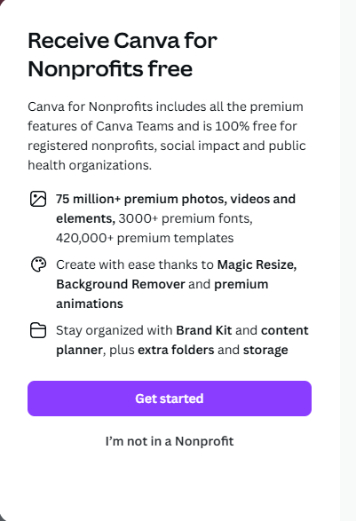
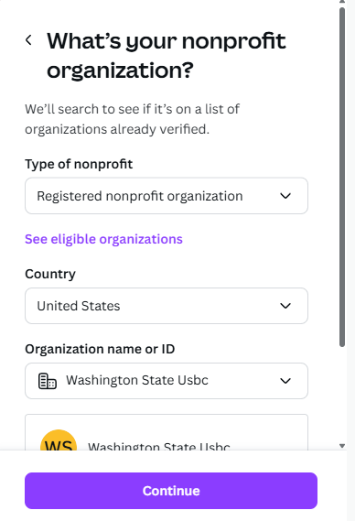
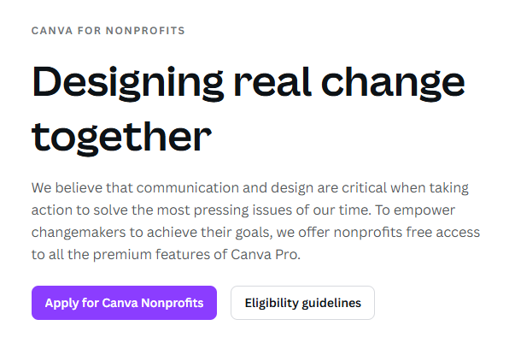
Canva for Non-Profits is FREE
https://www.canva.com/canva-for-nonprofits/

Slide 9
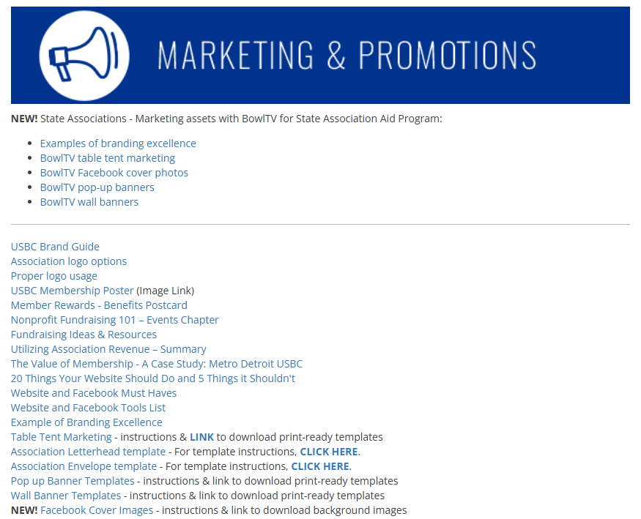

Resources: ARC
https://bowl.com/associations/arc-marketing-promotions

Slide 10
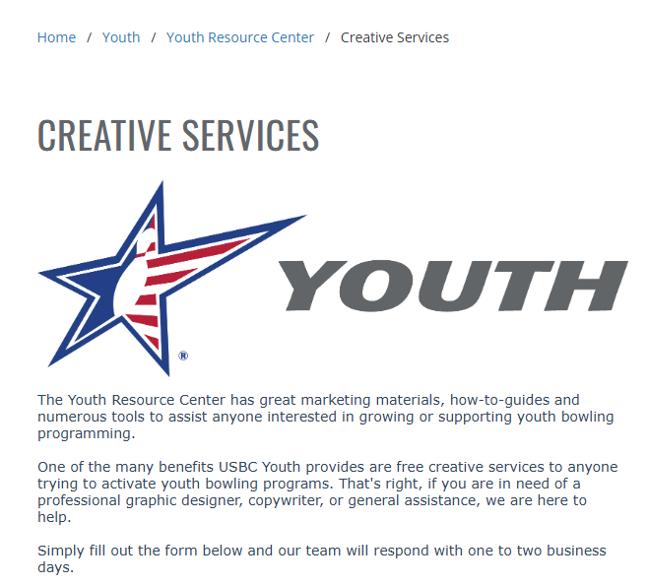
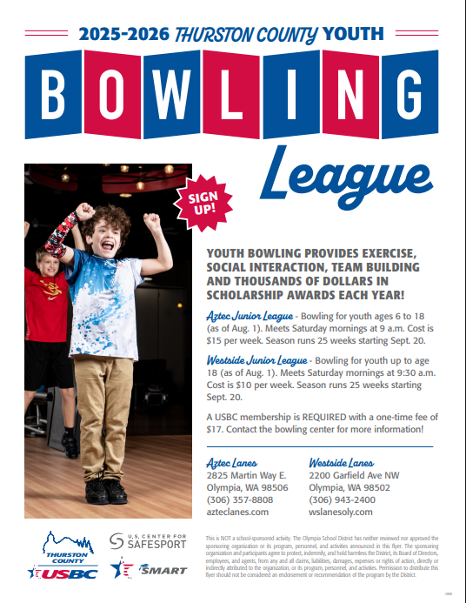
Resources: Youth Creative Services
https://bowl.com/youth/youth-resource-center/creative-services

Slide 11
Resources: Volunteering
Don’t have board capacity?
Offer SMART scholarships to youth bowlers interested in helping run your website & social media!

Slide 12
Thank you!

